Slide 1


Slide 2
SparkContext Overview
Definition:
The entry point for Spark functionality. It allows Spark to connect to a cluster, initialize the job execution environment, and configure job execution.
Responsibilities:
Managing the connection to the Spark cluster.
Scheduling jobs and tasks.
Configuring and monitoring the Spark application.
Deprecated in favour of SparkSession:
SparkContext was used before Spark 2.0. Although still available, it's recommended to use SparkSession for new applications.

Slide 3
Creating a SparkContext
Code Example:
from pyspark import SparkContext, SparkConf
# Configuration
conf = SparkConf().setAppName("MyApp").setMaster("local[*]")
# Initialize SparkContext
sc = SparkContext(conf=conf)
# Your Spark job logic here
# Stop SparkContext
sc.stop()

Slide 4
Explanation:
SparkConf() is used to configure the application.
setAppName("MyApp") sets the application name.
setMaster("local[*]") specifies the master URL for the cluster; local[*] runs Spark locally with as many worker threads as logical cores on your machine.
sc.stop() is used to stop the SparkContext once the job is done.

Slide 5
SparkSession Overview
Definition:
The new entry point for Spark applications starting from Spark 2.0. It encapsulates SparkContext and other services and provides a unified interface for working with Spark.
Responsibilities:
Provides access to the underlying SparkContext.
Manages DataFrame and SQL operations.
Configures and manages Spark application settings.

Slide 6
Creating a SparkSession
from pyspark.sql import SparkSession
# Initialize SparkSession
spark = SparkSession.builder \
.appName("MyApp") \
.master("local[*]") \
.getOrCreate()
# Example DataFrame operation
df = spark.createDataFrame([(1, "Alice"), (2, "Bob")], ["id", "name"])
df.show()
# Stop SparkSession
spark.stop()

Slide 7
Explanation:
SparkSession.builder is used to build a SparkSession.
.appName("MyApp") sets the application name.
.master("local[*]") specifies the cluster manager URL.
.getOrCreate() either returns an existing SparkSession or creates a new one if none exists.
spark.createDataFrame() is used to create a DataFrame.
spark.stop() stops the SparkSession and releases the resources.

Slide 8
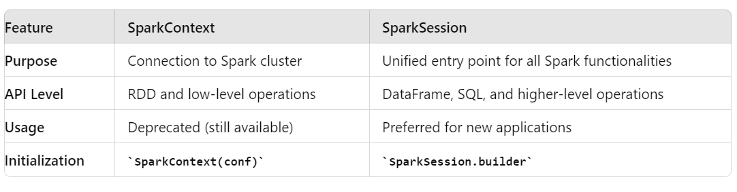
Key Differences Between SparkContext and SparkSession

Slide 9
When to Use Which?
Use SparkContext If:
Working with older codebases or maintaining legacy systems.
Directly manipulating RDDs and low-level configurations.
Use SparkSession If:
Starting new projects or applications.
Working with DataFrames, SQL, or DataSet APIs.
Want a unified and simplified entry point.

Slide 10
Best Practices
For SparkContext:
Use SparkSession instead for new applications.
Ensure sc.stop() is called to avoid resource leaks.
For SparkSession:
Use a single SparkSession throughout the application lifecycle.
Properly manage session lifecycle to avoid issues with multiple sessions.

Slide 11
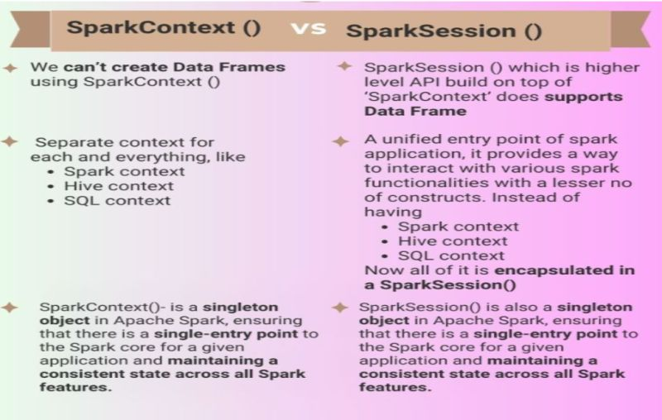

Slide 12


